Slide 1
Software Engineering
Topic 2
Introduction to Software Engineering Key Practices and Principles
Notes:
NCC Education - Title Master

Slide 2
The Unit Roadmap
Topic 1: Introduction
Topic 2: Introduction to Software Engineering Key Practices and Principles
Topic 3: Software Development Life Cycle Models
Topic 4: Requirement Engineering
Topic 5: System Modelling & Design
Topic 6: Software Implementation & Testing
Topic 7: System Dependency & Security
Topic 8: Project Management
Topic 9: Mini Project 1
Topic 10: Mini Project 2
Topic 11: Mini Project 3
Topic 12: Mini Project 4

Slide 3
Recap From Previous Lesson
Software is a piece of code which are used to manage and control the hardware resources in a computer system and to simulate human tasks in faster and better-quality way.
There are about 8 levels of software applications.
Software has specific characteristics which makes it creation and application different to physical objects and also makes challenges in this industry.
To resolve mentioned challenges, it is important to have a systematic method to control the quality of software development and it is important for software developers to adhere to predefined code of ethics.
Software societies have adopted systematic methods to resolve software development challenges known as “Software Engineering”.
Software engineering is about a set of principles, methods, processes and procedures, management skills, etc in order to develop high quality software.

Slide 4
Learning Outcomes
By the end of this topic students will be able to:
Describe the software product lifecycle
Explain why alternative software development lifecycles have been developed
Discuss the role of requirements engineering, system modelling, testing, maintenance, reuse, project management, cyber security in software engineering.
Explain software engineering design principles

Slide 5
Scope and Coverage
This topic will cover:
Software product lifecycle (SDLC)
Teamwork
Project management, productivity
Requirements engineering,
System Design, modelling, reuse
Object-Oriented Programming
Testing,
Configuration management
Maintenance,
Cyber security
Notes:
NCC Education - Slide Master

Slide 6
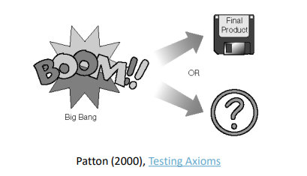
Big Bang Model
Big Bang theory explains the origin and evolution of the cosmos through a rapid and accident expansion event.
The Big Bang model of software developments follows much the same principle of the Big Bang theory for creation of the universe.
A lot of people, money, and resources are combined, a ton of effort is used, and the result could be either great software, terrible software, or nothing at all.
Little or no planning.
Little or no formal testing.

Slide 7
Build & Fix Model
The method used by Volkswagen to manufacture ‘Zwitter’ model.
No testing
Problem fixed through the usage
Faithful and patient customers
Repaired by dealer on own cost
Bug is fixed but is the process improved?
Jayaswal & Patton 2006
Functional Design (WHAT)
Technical Design
(HOW)
Implementation
Deployment
Usage
Problem
Bug Report
Vendor Evaluation
Fix
Upgrade

Slide 8
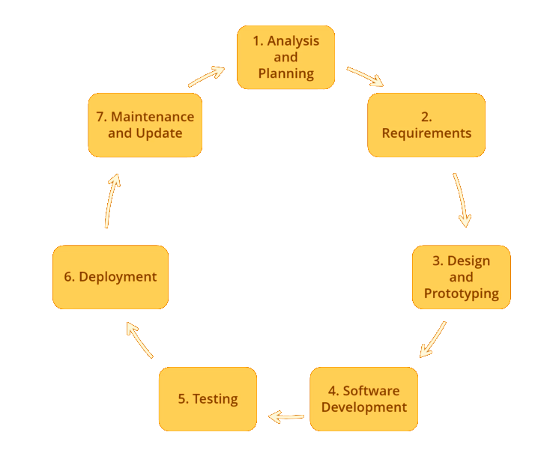
Software Development Life Cycle
Analysis & Planning: System analysts and stakeholders will strategise, allocate funds, and evaluate the expenses, transfer, and feasibility of the project. If satisfied with the progress, they will organize the project team.
Requirement: system analysers/stakeholders identify functional and non-functional requirements of the system.
Design & Prototype: system designers design models of system according to the requirements.
Improve the project?
Taking the
project?

Slide 9
Software Development Life Cycle
System Development: Implement and code the requirements.
Testing: examine if the outcome product fulfil the requirements.
Deployment: put the software to a server for customer usage.
Maintenance & Update: improve and adjust for further needs.

Slide 10
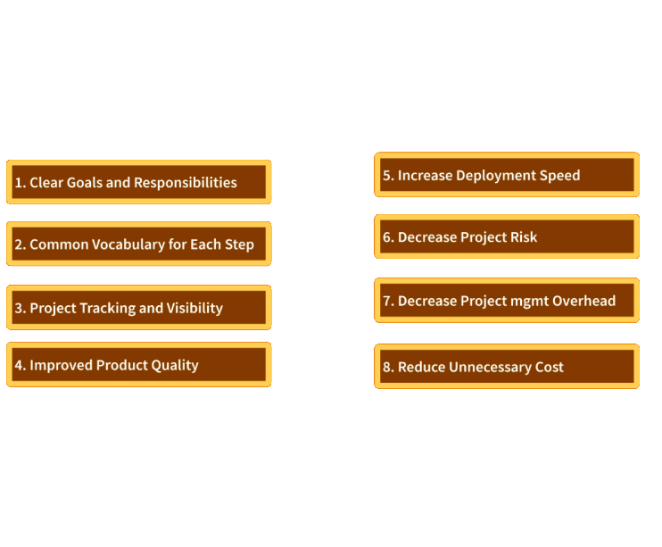
Benefits of SDLC
"If you fail to plan, you're planning to fail" -Benjamin Franklin

Slide 11
Software Reuse
Reuse refers to using existing assets in solving different problems
Systematic software reuse leads to saving time and cost and enhancing reliability, productivity and quality
Typical assets that are reused In software construction:
libraries,
modules,
components,
source code,
commercial off-the-shelf (COTS) assets
IEEE Std. 1517-2010 Standard for Information Technology—System and Software Life Cycle Processes—Reuse Processes: it provides a common framework for extending the system and software life cycle processes of IEEE Std. 12207:2008 to include the systematic practice of reuse in any relevant stages of SDLC.

Slide 12
Software Reuse, Components & Patterns
Reuse Element | Description
Design Pattern | Generic abstractions that occur across different applications
Component-based development | Systems are developed by integrating pre-developed standardised components
Application frameworks | Collections of abstract and concrete classes that can be adopted and extended in new applications
Application product lines | An application type is generalised around a common architecture
Program libraries | Class and function libraries implementing commonly-used abstractions
Aspect-oriented software development | Shared components are woven into an application at different places when the program is compiled
Sommerville, I. (2004) Software Engineering, 7th edition, Chapter 18

Slide 13
Object-Oriented Programming
Object-Oriented Programming (OOP) is a popular paradigm in software engineering that organizes data and behaviour into reusable and maintainable units called objects.
Object-oriented programming is a computer programming model that organises software design around data, or objects, rather than functions and logic.
An object can be defined as a data field that has unique attributes and behaviour.
Well-suited for programs that are large, complex and actively updated or maintained
Examples of an object can range from physical entities, such as a human being who is described by properties like name and address, to small computer programs, such as widgets.
Objects can communicate with well-defined interfaces called messages.

Slide 14
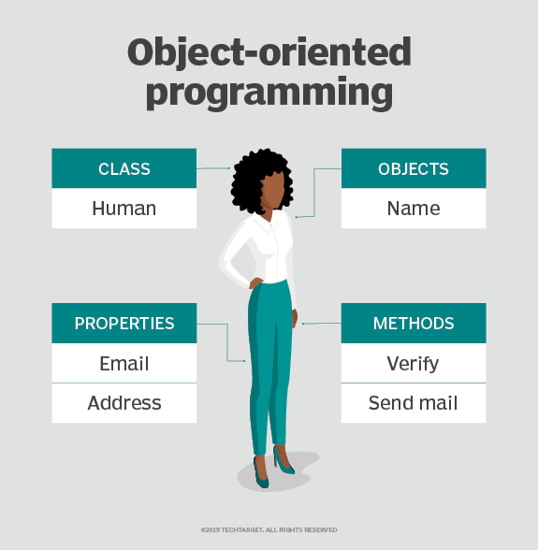
Object-Oriented Programming
Elements of OPP:
Class: user-defined data types that act as the blueprint for individual objects, attributes and methods.
Objects are instances of a class created with specifically defined data.
Methods are functions that are defined inside a class that describe the behaviours of an object.
Attributes are defined in the class template and represent the state of an object.
www.TechTarget.com

Slide 15
Short Activity
Thinking about software reuse, try to find challenges facing in this strategy in a group discussion.

Slide 16
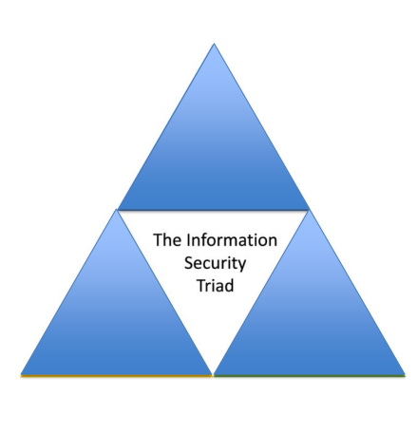
Cyber Security Fundamental Concepts
What is Cyber Security?
CIA Triad
It refers to a set of activities and measures, both technical and non-technical to protect cyber space against possible threats
Confidentiality:
Ensuring only eligible persons are able to access the information
Integrity
Ensuring the stored data is correct
Availability
Ensuring the systems and data are constantly accessible

Slide 17
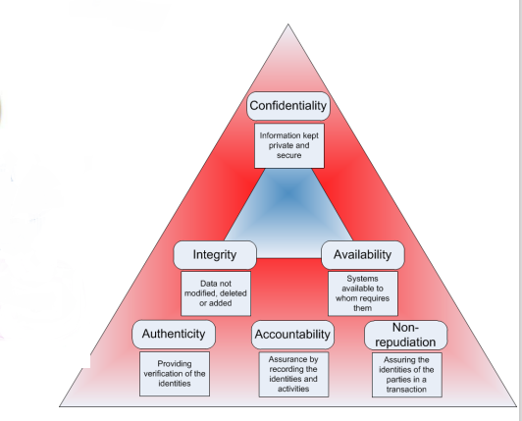
More Protection Services
Security
Information Privacy Short Guide- Office of the Victorian Information Commissioner

Slide 18
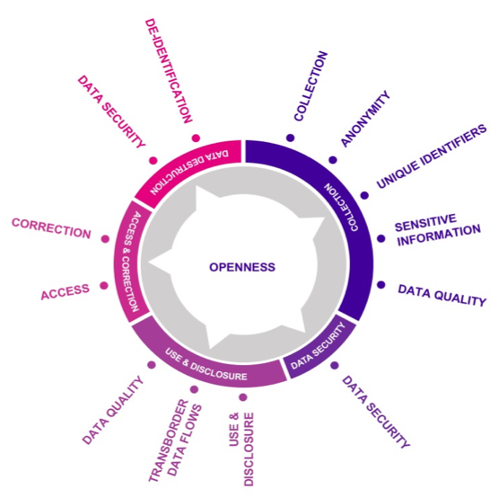
Privacy
Information Privacy Short Guide- Office of the Victorian Information Commissioner

Slide 19
Checkpoint Summary
SDLC is a systematic approach in software development to solve the challenges of no-plan development
SDLC includes 7 stages of development from system analysis to maintenance
Software reuse is a new approach to software engineering which helps to save time and resources
Information security is one of the main critical non-functional requirements of software system which include 3 principles of confidentiality, Integrity and Availability (CIA)
Privacy is also another important non-functional requirement which has been more emphasised in software development after GDPR implementation in 2018

Slide 20
Secure Software Lifecycle
Reactive approach to software security: Historically organisations have focused their security strategies at the network system level, such as with firewalls, penetration testing, etc. (Cybok, 2021)
proactive rigorous software analysis should play an increasingly important role in assessing and preventing vulnerabilities (McGraw, 1998)
The aim is to integrate security and privacy engineering into SDLC
known as “Security and privacy by design”
Secure coding: Microsoft announced the delay of the release of Windows .NET Server [8] to ensure a proper security review (referred to as the Windows Security Push)
Approaches to Secure SDLC
Microsoft Security Development Lifecycle (SDL)
Touchpoint
SAFECode

Slide 21
Microsoft SDL
Microsoft SDL contains 12 practices
Provide Training
Define Security Requirements
Define Metrics and Compliance Reporting
Perform Threat Modelling
Establish Design Requirements
Define and Use Cryptography Standards
Manage the Security Risk of Using Third-Party Components
Use Approved Tools
Perform Static Analysis Security Testing (SAST)
Perform Dynamic Analysis Security Testing (DAST)
Perform Penetration Testing
Establish a Standard Incident Response Process
Microsoft SDL: Microsoft Security Development Lifecycle Practices

Slide 22
TouchPoint
International software security consultant, Gary McGraw, provided seven Software Security Touchpoints [10] by codifying extensive industrial experience with building secure products:
Code Review (Tools)
Architectural Risk Analysis
Penetration Testing
Risk-based Security Testing
Abuse Cases
Security Requirements
Security Operations

Slide 23
Comparing the Secure Software Lifecycle Models
www.cybok.org
 | Microsoft SDL | Touchpoint | SafeCode
Education & awareness | Provide training
Project inspection | Define metrics & compliance reporting Define & use cryptography standards Use approved tools
Analysis & requirement | define security requirements Perform threat modelling | Abuse cases Security requirements | Application security control definition
Architectural & detailed design | Establish design requirements Perform statistical analysis security testing (SAST) Perform dynamic analysis security testing (DAST) | Architectural risk analysis | Design
Implementation & test | Perform penetration testing Define and use cryptography standards Manage the risk of third-party components
Release, deployment & support | Establish a standard incident response process | Security operation | Vulnerability response & disclosure
Notes:
This table is comparing capabilities of the secure SDLCs that we discussed in today lectures, as Microsoft SDL, Touchpoint and SafeCode. The metrics to compare are education and awareness, project inspection, analysis and requirement, architectural and detail design, implementation and test and finally release, deployment and support. The model which meets all of these criteria, is Microsoft SDL.

Slide 24
Short Activity
In group of 2 or 3, search and identify security safeguarding and protecting methods and technologies used in organisations. These should include technical and non-technical measures.
Discuss strength and shortage of using discussed measures.

Slide 25
The Nature of the Project Management
A Project is a set of activities in order to achieve some goals, for example to develop a software
6 main factors of project management
Change is in the centre
In the event of change to any of the 6 elements, project manager needs to balance the other elements with the change
Scope
(features, functionality)
Quality
Resources
CHANGE
Cost
(budget)
Time
(schedule)
Risk
beside on PMBOK® Guide 3rdEdition & PMBOK® Guide 4th Edition

Slide 26
Short Activity
As a project manager of a web development company, you have contracted a client to deliver their business e-commerce in one month with a specific and limited budget. After one week of starting project development, client contact you and ask to add more functionalities to the e-commerce.
In group of 2 to 3, discuss what actions you would do as a project manager to cope the project with this change. You may discuss solutions in step-by-step actions, if client does not agree with your first suggestions.

Slide 27
Project Management
Develop
Design
Evaluate
Planning
Organising
Staffing
Directing
Monitoring
Controlling
Innovating
Representing
Analysis

Slide 28
Project Planning
Understand the goal and how to achieve it
Identify activities / tasks
List all activities and tasks to be carried out
Create work breakdown structure
Estimate how long each activity will take
Indicate dependencies which activities / task must be complete before others can be started
Allocate activities to team personnel
Adjust the plan as necessary as project unfolds*
Notes:
goal could be straightforward or obscure
why breakdown
identify all activities vs dealing with potential changes

Slide 29
Activity bar & Staff Allocation chart
Sommerville, I. (2015) Software Engineering, 10th edition. Chapter 23

Slide 30
Work and Product Breakdown Structure
Project
Analyse
Physical design
Logical design
Build
Design
Requirements identification
Unit testing
Coding
Feasibility study
Requirements specification
Project product
Analyse product
Physical model
Logical model
Build
Design
Requirements list
Test report
Module code
Feasibility study report
SySR
Notes:
coding is only small part of a real project

Slide 31
Approaches to Estimating
Estimates made by an expert. An expert in the business field and the programming language provides estimates.
Estimates made using reasoning by analogy. A similar type of project is examined and compared to the new project.
Estimates based on price-to-win. The amount the client can afford is considered, and competitive bidders are undercut.
Estimates based on available capacity. If we have limited staff resources, then that may determine what we can do.
Estimates based on use of parametric methods. Parametric methods use equations to derive estimate – equations contain constants derived from statistical studies of a large number of projects.

Slide 32
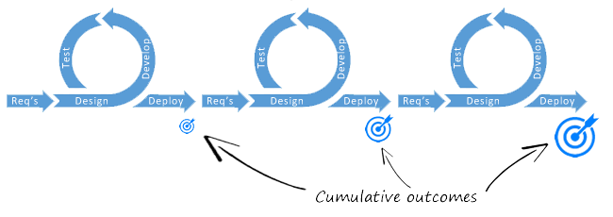

Traditional vs Agile Planning
Traditional Model
Agile Model
Detailed plan completed before moving on to the next development stage
Different members of team contribution to the project depends on the stage of the project
Lack of (or low) customer involvement
Incremental and flexible plan adjusted to the current situation if required
Whole team contributes to the project throughout the development life cycle
Close cooperation with customer
Notes:
What is agile?
whole team: frontend html, javascript; backend: database
whole team contributes: encourage developers switch their roles. Ask why?
close cooperation with customer: response to change immediately rather than start over again

Slide 33
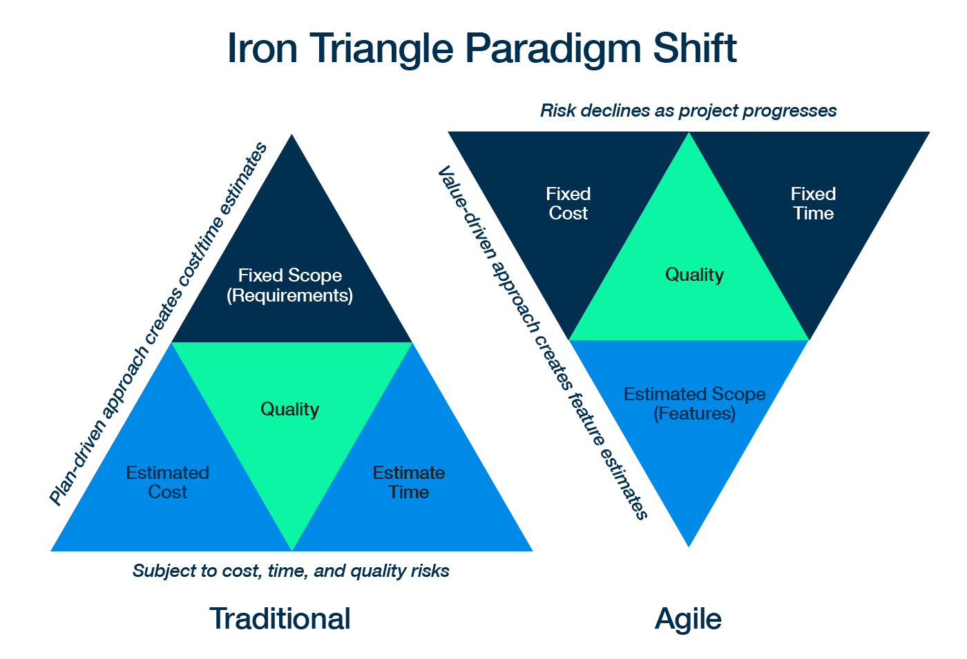
Iron Triangle Paradigm shift

Slide 34
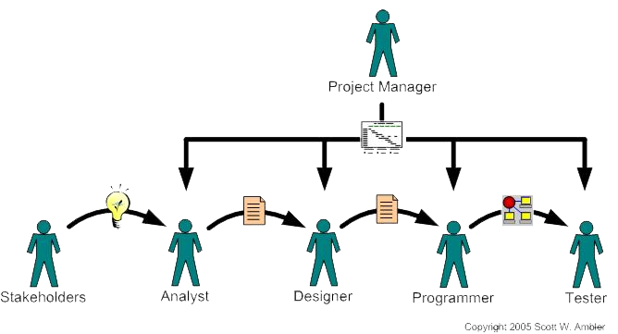
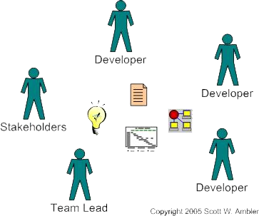
Development Team
A traditional software development team
An agile software development team
Scott W. Ambler (2005) Generalizing Specialists: Improving Your IT Career Skills
Notes:
no arrows, why
developers (designers, programmers, an d tester) sitting with stakeholders, why? easy communication; agile for leader

Slide 35
Roles in a Typical Software Development Project
Expertise | Responsibilities
Business Analyst | Develop and maintain requirement documents
Content Strategy | Responsible for writing contents using plain language and search optimisation techniques
Project manager | Develop project plan, acquire project resource, leads meetings, monitoring, etc.
Quality Assurance | Develop QA plan and audit report on compliance
Technical developer | Coding by programming languages such as JAVA, C, Python, HTML, CSS..
Usability Testing | Evaluating quality of a user experience when using a product
UI designer | Creating consistence and predictable user interfaces
Interaction Designer | Uses information about user’s goals and requirements to design processes and interactions between them (UML)

Slide 36
Summary
Software security has become one of the critical topics in software engineering. Secure SDLC methods are developed in order to integrate security into all stages of software development. It has been proved to be better approach to after-the fact security solutions
Project management is a major topic in software engineering which helps to balance changes in projects.
Project management include many tasks such as planning, estimation, organising, monitoring and etc.
Project planning as one of the main tasks of project management involve defining project’s tasks, estimating efforts for them and allocating team members to tasks
When allocating tasks to team, it is important to organise development teams according to SE model used, Waterfall or Agile. The difference in nature of these models affect the way tasks and teams are structure.
This topic along with the previous is providing fundamental concepts and practices in software engineering, opening the door to the following topics.

Slide 37
Quiz
True or False?
project planning is one of the tasks in feasibility study stage
coding is a stage occurring after design in SDLC
Software re-use is an approach in software engineering which benefits the time, budget and efforts
time and cost are fixed in waterfall model while scope is flexible
Fill the blanks:
CIA Triad is about -----------, -------------, and --------------.
development teams in agile projects are -------------------.
project managers list ------------- and ------------ in project planning.
Project managers estimate ------------ ,------------and -----------of the project.

Slide 38
The Unit Roadmap – Next Lesson
Topic 1: Introduction to Software Engineering Module
Topic 2: Introduction to Software Engineering Key Practices and Principles
Topic 3: Software Development Life Cycle Models
Topic 4: Requirement Engineering
Topic 5: System Modelling & Design
Topic 6: Software Implementation & Testing
Topic 7: System Dependency & Security
Topic 8: Project Management
Topic 9: Mini Project 1
Topic 10: Mini Project 2
Topic 11: Mini Project 3
Topic 12: Mini Project 4

Slide 39
Next Session
Topic 3: Software Development Life Cycle Models
To discuss different models for SDLC
To be able to distinguishes between different SDLC models and choose the best appropriate to a project
To get into more details of agile SDLC and how change is controlled in agile

Slide 40
References
A guide to the Project Management Body of Knowledge (PMBOK guide) (2008). Newtown Square, PA: Project Management Institute.
Hughes, B. (ed.). (2019) Project Management for IT-related projects, 3rd edn. Swindon: BCS Learning & Development.
Jayaswal, B. (2021) Software quality metrics, Developer.com. Available at: https://www.developer.com/design/software-quality-metrics/ (Accessed: 28 February 2024).
Martin, A., Rashid, A., Chivers, H., Schneider, S. and Lupu, E. (n.d).Introduction to CyBok Knowledge Area Version
Sommerville, I. (2016), Software Engineering, 10th edition

Slide 41
Topic 2 – Introduction to Software Engineering Key Principles and Practices
Any Questions?
Notes:
NCC Education - End Slide Master

